Slide 1

STUDENT MANAGEMENT SYSTEM
AN EXTENSION TO HMIS
Developed At:
Developed By:
Raja Biswas (IT-07)
Student ID: ST03IT070016
Project ID: 32
Internal Guide:
External Guide:
Mr. Rahul Joshi
Mr. Devendra Thakur
Mr. Dhaval Patel
(BA, TCS - Gandhinagar)

Slide 2
INTRODUCTION
Definition:
  A Student Management System (SMS) for HMIS is a system that manages the records of student regarding admission and examination part.
SMS involves
  Manage fees structure
  Roll number generation
  Fees payment
  Admission seat management
  Exam scheduling
  Result management
  Manage new admission

Slide 3
MOTIVATION
To meet a solution to manage dental students’ records across hospitals of Govt. of Gujarat for Hospital Management Information System in 30 districts.
To overcome existing problems occurring in maintenance of students’ information

Slide 4
OBJECTIVES
To manage students’ information during admission and examination.
  Efficient utilization of human resource.
  To reduce unnecessary paper work in maintaining students’ information.

Slide 5
APPLICATIONS
To use for various streams‘ students.
To gather students’ information.
Different reports and Queries can be generated based of vast options related to students, batch, course, quota, semesters and category and even for the entire college.

Slide 6
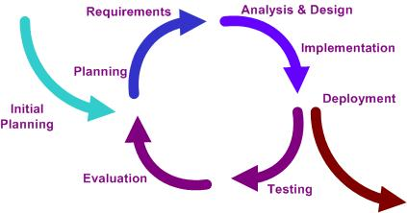
METHODOLOGY
Iterative and Incremental Life Cycle

Slide 7
ARCHITECTURE OF SMS
Data Layer
Database
Business Layer
Control Layer
Presentation Layer

Slide 8
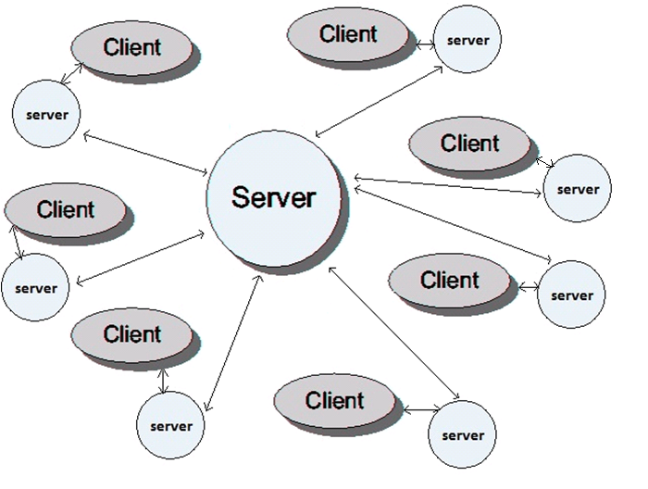
ARCHITECTURE OF SMS..

Slide 9
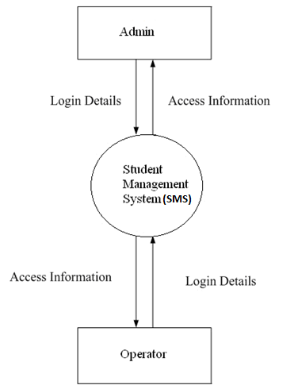
CONTEXT DIAGRAM OF SMS

Slide 10
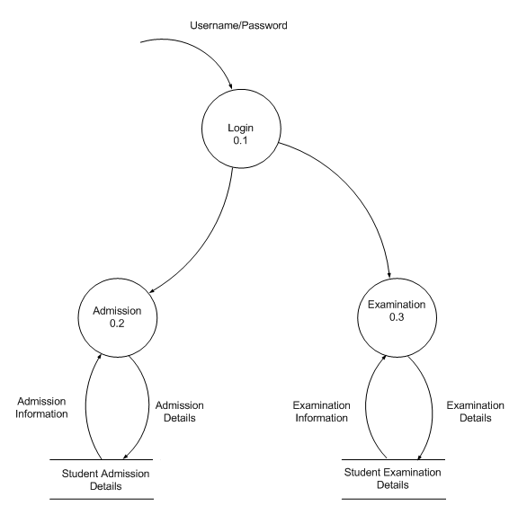
LEVEL-1 DATA FLOW DIAGRAM OF SMS

Slide 11
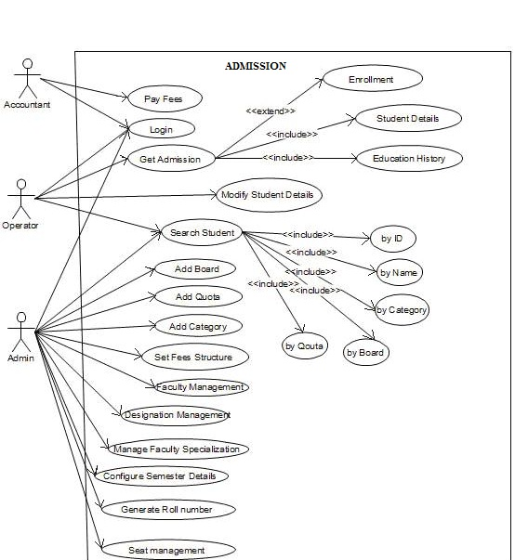
USE CASE DIAGRAM OF ADMISSION MODULE

Slide 12
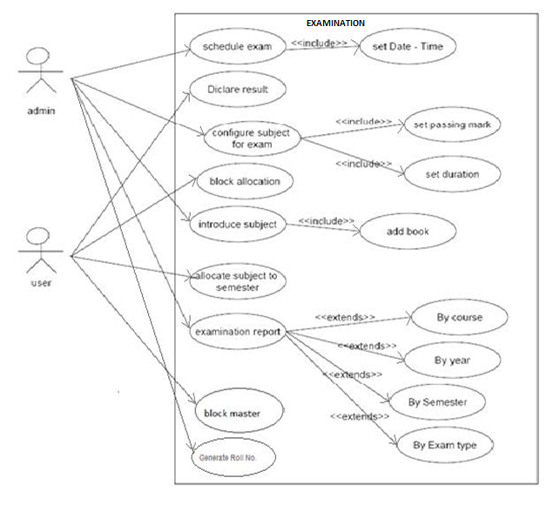
USE CASE DIAGRAM OF EXAMINATION MODULE

Slide 13
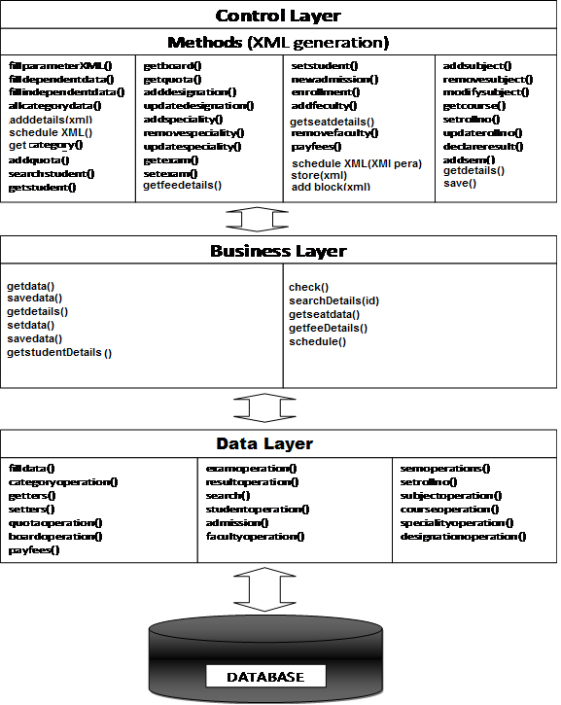
CLASS DIAGRAM

Slide 14
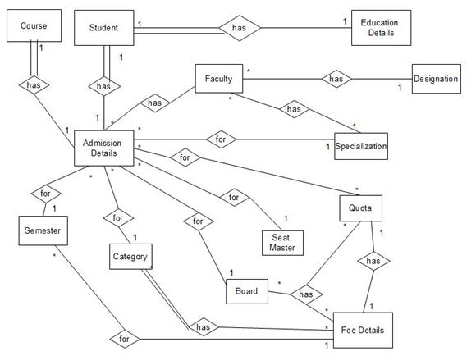
E-R DIAGRAM OF ADMISSION MODULE

Slide 15
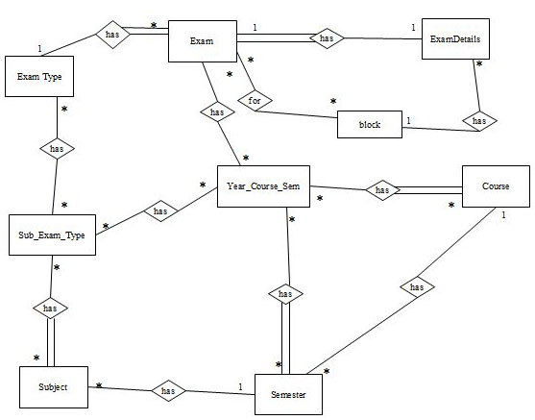
E-R DIAGRAM OF EXAMINATION MODULE

Slide 16
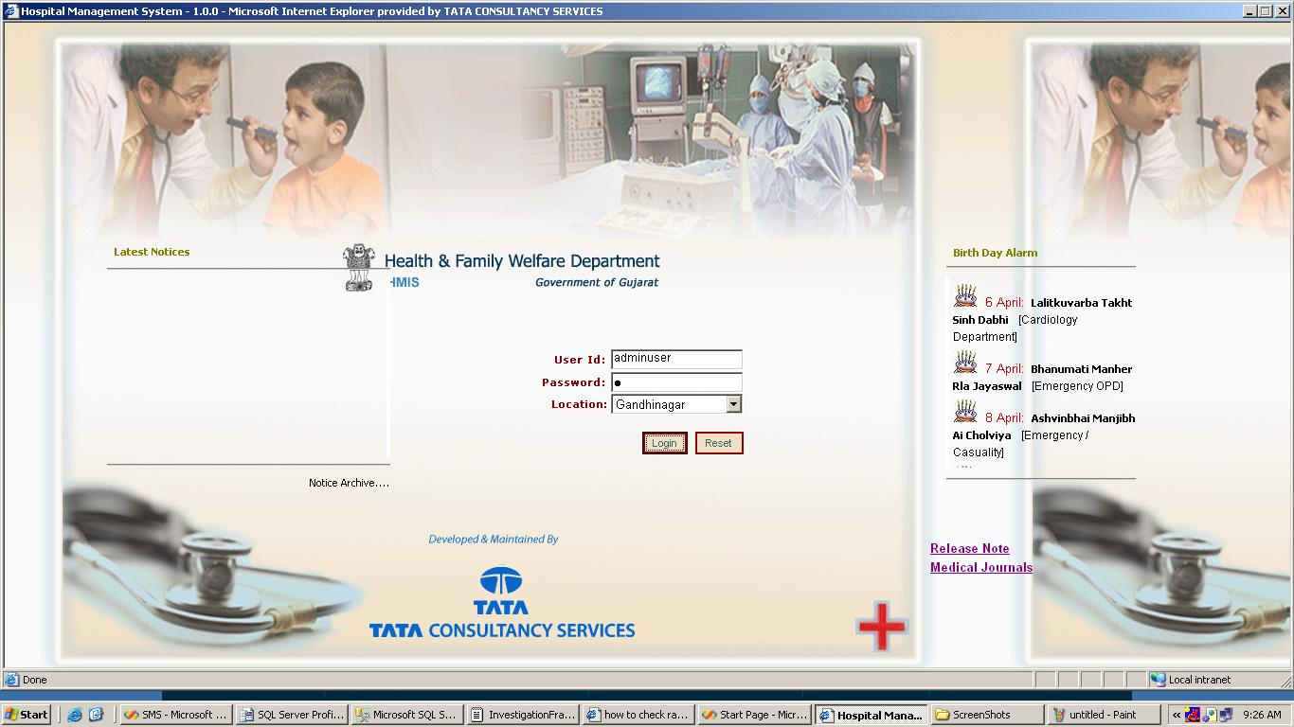
SCREEN SHOT SHOWING LOGIN SCREEN
Location Of
Client

Slide 17
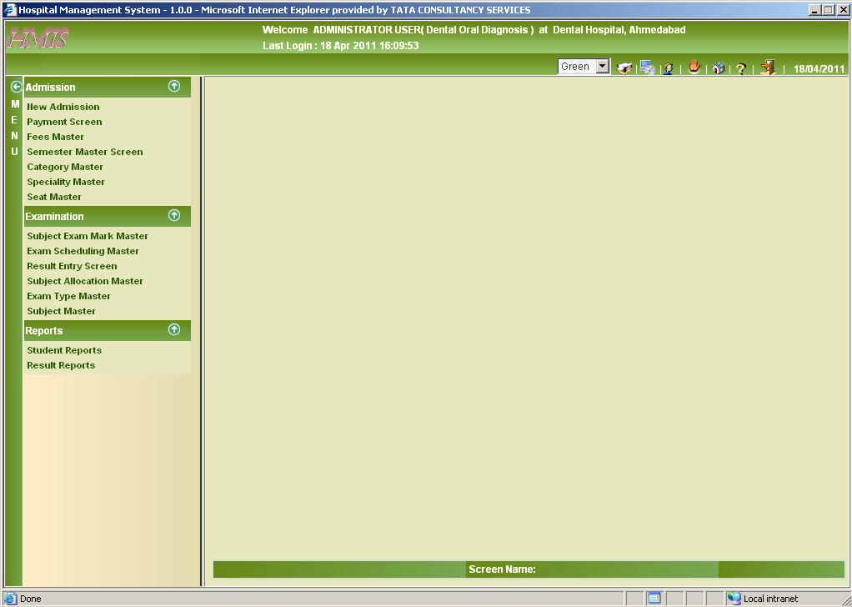
SCREEN SHOT SHOWING PAGE DETAILS
Module
Name
To Change
Theme
Logout
List of Screen
Screen Name
Mode of the
Screen

Slide 18
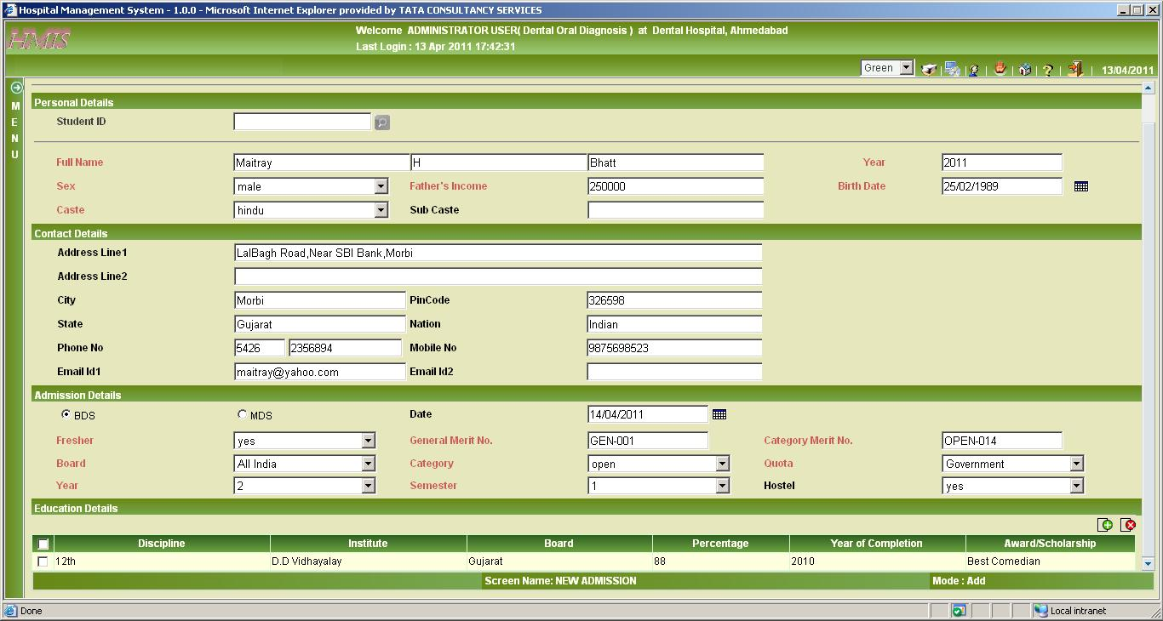
SCREEN SHOT SHOWING NEW ADMISSION SCREEN
Add Mode

Slide 19
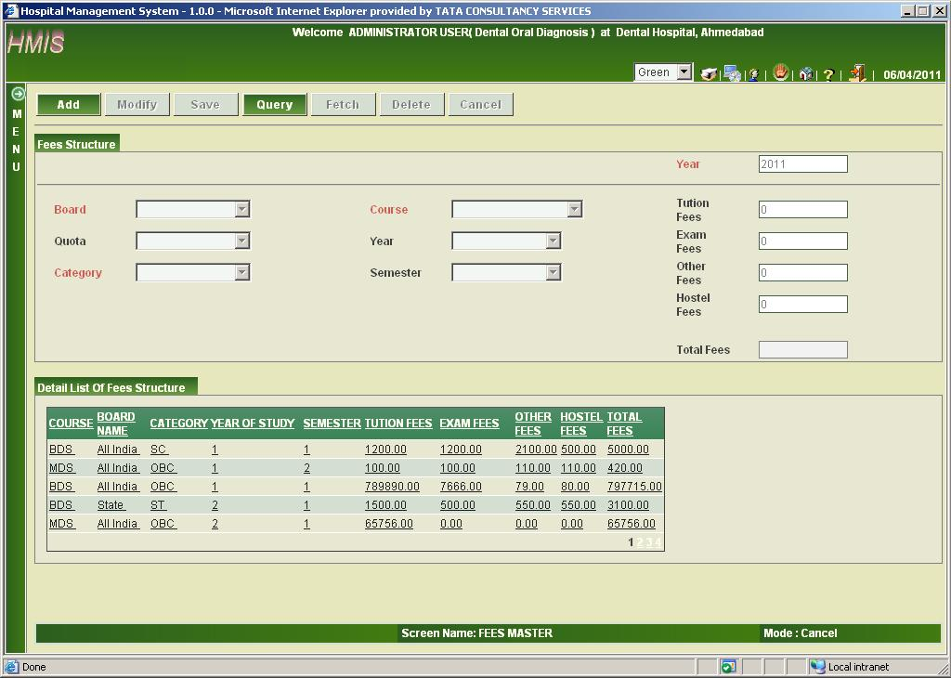
SCREEN SHOT SHOWING FEES DETAILS
Table showing all details of fees
Cancel mode

Slide 20
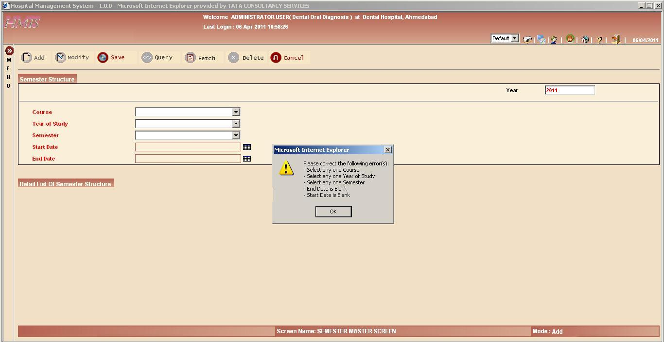
SCREEN SHOT SHOWING SEMESTER MASTER VALIDATIONS
Message box showing list of errors
Semester master screen name

Slide 21
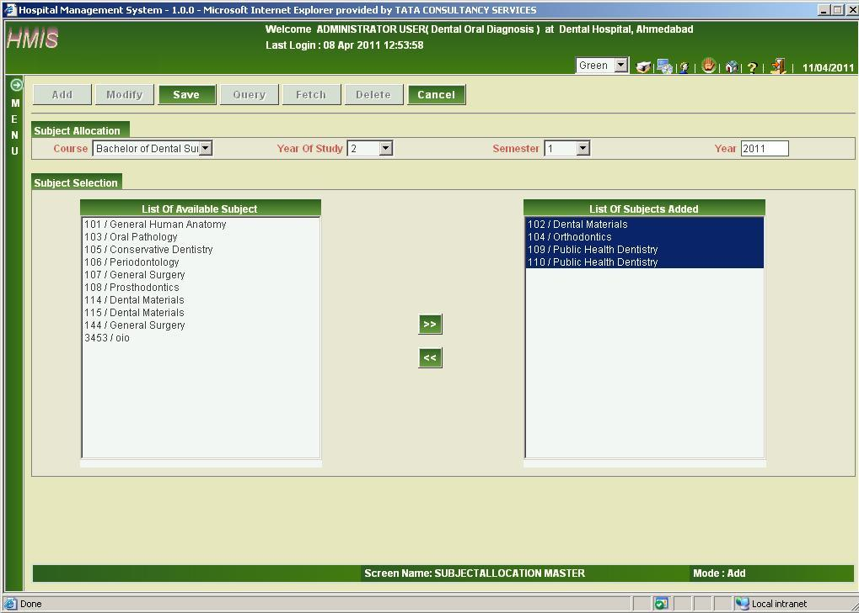
SCREEN SHOT SHOWING SUBJECT ALLOCATION SCREEN
Allocated subjects
Available subjects

Slide 22
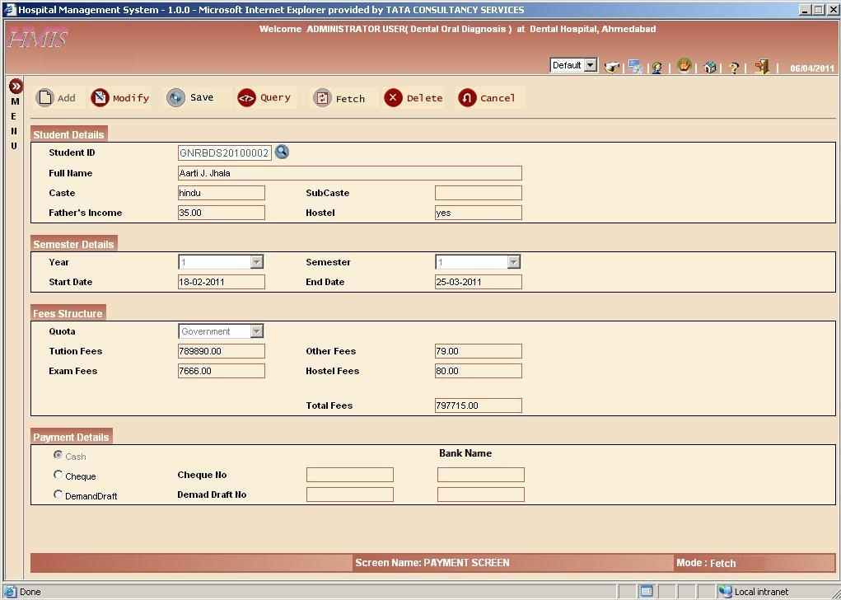
SCREEN SHOT SHOWING PAYMENT DETAILS
LoV control to select student
Fetch mode

Slide 23
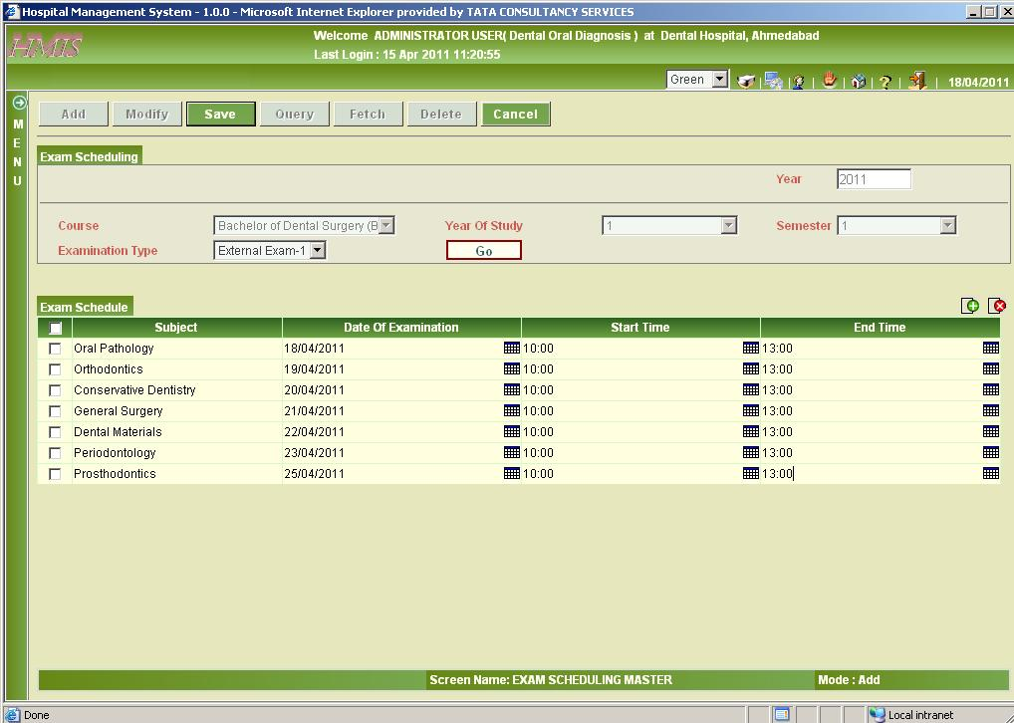
SCREEN SHOT SHOWING EXAM SCHEDULING SCREEN
To remove selected rows
Calendar control to add date and time

Slide 24
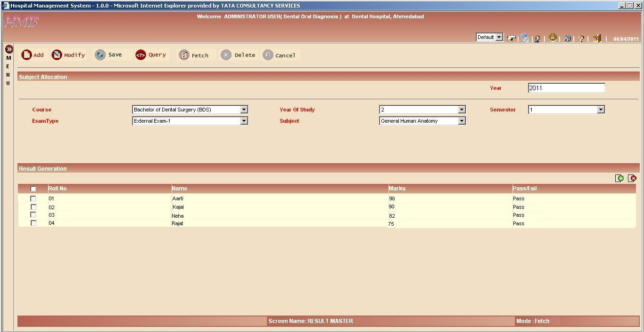
SCREEN SHOT SHOWING RESULT ENTRY SCREEN
List of students with their marks in particular subject

Slide 25
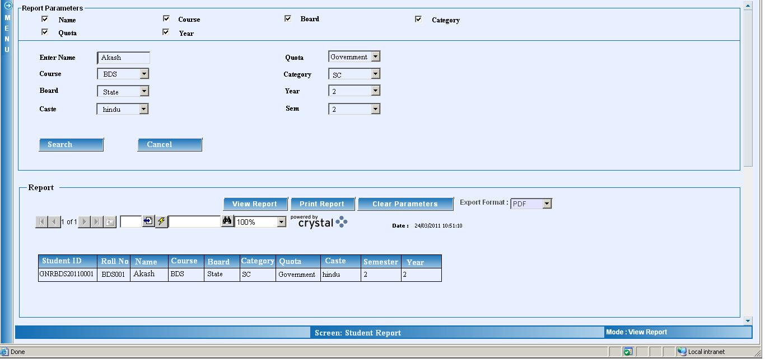
SCREEN SHOT SHOWING STUDENT REPORT SCREEN
Parameters in report
To get printout of report

Slide 26
CONCLUSION
helpful to perform paperless work and manage all data
provides easy, accurate, unambiguous and faster data access.

Slide 27
FUTURE ENHANCEMENTS
This Project can be implemented in more than two languages.
Other Possible Modules
  Academic
  Attendance Management
  Lab Management
  Library
  Hostel

Slide 28
BIBLIOGRAPHY
Websites
  http://www.tcs.com
  http://www.msdn.microsoft.com
  http://www.codeguru.com
  http://www.1001tutorials.com
Books
  Asp.net Professional 1.1 (Wrox Publication)
  Javascript In 21 Days
  VB.net Professional (Wrox Publication)
  Software Engineering - A Practitioner’s Approach

Slide 29


